Slide 1
Modern Web Development
Ruby
Rack
Sinatra
Rails
Aufbau (MVC)
Model
Routing
Controller
View
Data Access
Active Record Pattern
Associations / Migrations
TDD
Rspec, Minitest, Cucumber
TDD und DHH
Frontend Development
Assets (CSS, JS, Images)
Turbolinks & Websockets
Singlepage Applications
Rails Advanced
Features
Und Gems
Sonstiges
Advanced Ruby
REST-API
Deployment
Klausur
Notes:
50 min incl. DSL und Rest-API Demo

Slide 2
Ruby – DSL
Domain Specific Language
Deklarative Beschreibung
Interne DSL
Erbt Eigenschaften der Wirtssprache (Mächtigkeit, Syntax, Bibliotheken)
Beispiel: rake, Gemfile, rails
Externe DSL
Eigener Parser/Compiler
Beispiel: SQL, Regular Expressions, YAML
Notes:
Rails ist eine WebDSL

Slide 3
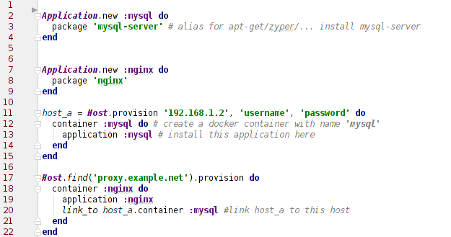
Ruby – DSL

Slide 4
Ruby – DSL
Host.find('proxy.example.net').provision do
container(:nginx) { application :nginx }
end
Könnte auch so geschrieben werden
host = Host.find('proxy.example.net').provision
host.container(:nginx).application(:nginx)
Notes:
https://github.com/DHBW-KA/smutje

Slide 5
TDD – Test Doubles
Warum?
Schnellere Tests
Vorhersagbare Testergebnisse
Isolation
Was?
Externe Dienste (REST-Services, RPC, …)
Nicht unbedingt die Datenbank

Slide 6
TDD – Test Doubles: Wie?
Dummy
are passed around but never actually used. Usually they are just used to fill parameter lists.
Fake
actually have working implementations, but usually take some shortcut
Stubs
provide canned answers to calls made during the test
Spies
record some information on how they were called. Eg. Fake email service
Mocks
a specification of the calls they are expected to receive.
throw an exception if they receive a call they don't expect
http://www.martinfowler.com/bliki/TestDouble.html

Slide 7
Rest API
rails new rest_api --api
rails g scaffold user name email
Visit: http://localhost:3001/users
Seeds
Active Model Serializers
CORS (Cross Origin Resource Sharing)
Authentication (Token Based)
Nur Über SSL
https://github.com/DHBW-KA/rails_api
Notes:
CORS =Cross Origin Ressource Sharing

Slide 8
Development Setup mit Docker Compose
db: image: postgres environment: POSTGRES_PASSWORD: dev volumes: - "./db/data:/var/lib/postgresql/data" ports: - "5432:5432" redis: image: redis ports: - "6379:6379"
https://www.docker.com/products/docker-compose
$> docker-compose up

Slide 9
Deployment
Webserver
Apache
NginX
Rack-Server
Passanger
Puma
Unicorn
Thin
Webrick (Ruby)
Datenbank
Postgres
MySQL
SQLite
Redis (Worker Kommunikation / Cache)
Notes:
Was braucht man

Slide 10
Deployment Manuell/Automatisch
Manuell (SSH)
Upload
NginX setup
Rails setup
NginX starten
Rails starten
Ggf. Externe Worker starten
Halbautomatisch (Capistrano)
Capistrano Setup
Upload
Fast Automatisch (Heroku / Dokku)
Upload
(DBs linken)
Cloud-Native
Kubernetes

Slide 11
Cloud Native - Voraussetzungen
Cluster Setup
Any Hyperscaler (AWS, GCP, Azure, Ali) - https://gardener.cloud/
https://k3s.io/
https://minikube.sigs.k8s.io/docs/
https://docs.docker.com/get-docker/ Docker Desktop (Mit K8s)
Docker Image
Container ist die Instanz eines Image
Enthält alle Abhängigkeiten
Prozess-Isolation

Slide 12
Docker Image
Dockerfile
FROM ruby RUN mkdir /app && gem install bundler WORKDIR /app COPY Gemfile* package.json yarn.lock /app/ RUN bundle install && yarn install COPY . /app CMD ["bundle", "exec", "puma", "-c", "config/puma.rb"]

Slide 13
Kubernetes
Container Orchestrator
Deklarative Systemdefinition
Alles ist eine “Resource”
Deployment – Mehrere Versionen einer Applikation
Replica-Set – Duplikate der selben App-Version auf dem Cluster verteilt
Pod - enthält 1-n Container der Applikation in einer Version
Service – Applikation im erreichbar machen
Ingress – Service an einen DNS binden (incl Reverse-Proxy, SSL, etc.)
PersistentVolumeClaim – Speicherplatz Anforderung
PersistentVolume – Bereitstellung. Kann im Pod angebunden werden
CRD – Custom Resource Definition

Slide 14
Resources: Deployment
apiVersion: apps/v1 kind: Deployment metadata: name: hello-k8s-world labels: app: hello-k8s-world spec: selector: matchLabels: app: hello-k8s-world template: metadata: labels: app: hello-k8s-world spec: containers: - name: hello-k8s-world image: hello-k8s-world:latest ports: - containerPort: 3000 resources: limits: cpu: 400m memory: 1Gi
Resource Type
Metadata
Spec
Automatisch erzeugte Resourcen:
ReplicasSet
Pod

Slide 15
Resources: Service
kind: Service apiVersion: v1 metadata: name: hello-k8s-world labels: app: hello-k8s-world spec: selector: app: hello-k8s-world ports: - name: hello-k8s-world protocol: TCP port: 3000 targetPort: 3000
Resource Type
Metadata
Spec
Selector: Referenz auf die Metadata eines Pod

Slide 16
Resources: Ingress
kind: Ingress apiVersion: extensions/v1beta1 metadata: name: hello-k8s-world labels: app: hello-k8s-world spec: tls: - hosts: - hello.example.com rules: - host: hello.example.com http: paths: - path: / backend: serviceName: hello-k8s-world servicePort: 3000
Resource Type
Metadata
Spec
Referenz auf den Service

Slide 17
Beispiel
https://github.com/DHBW-KA/rails-on-k8s

